Slide 1
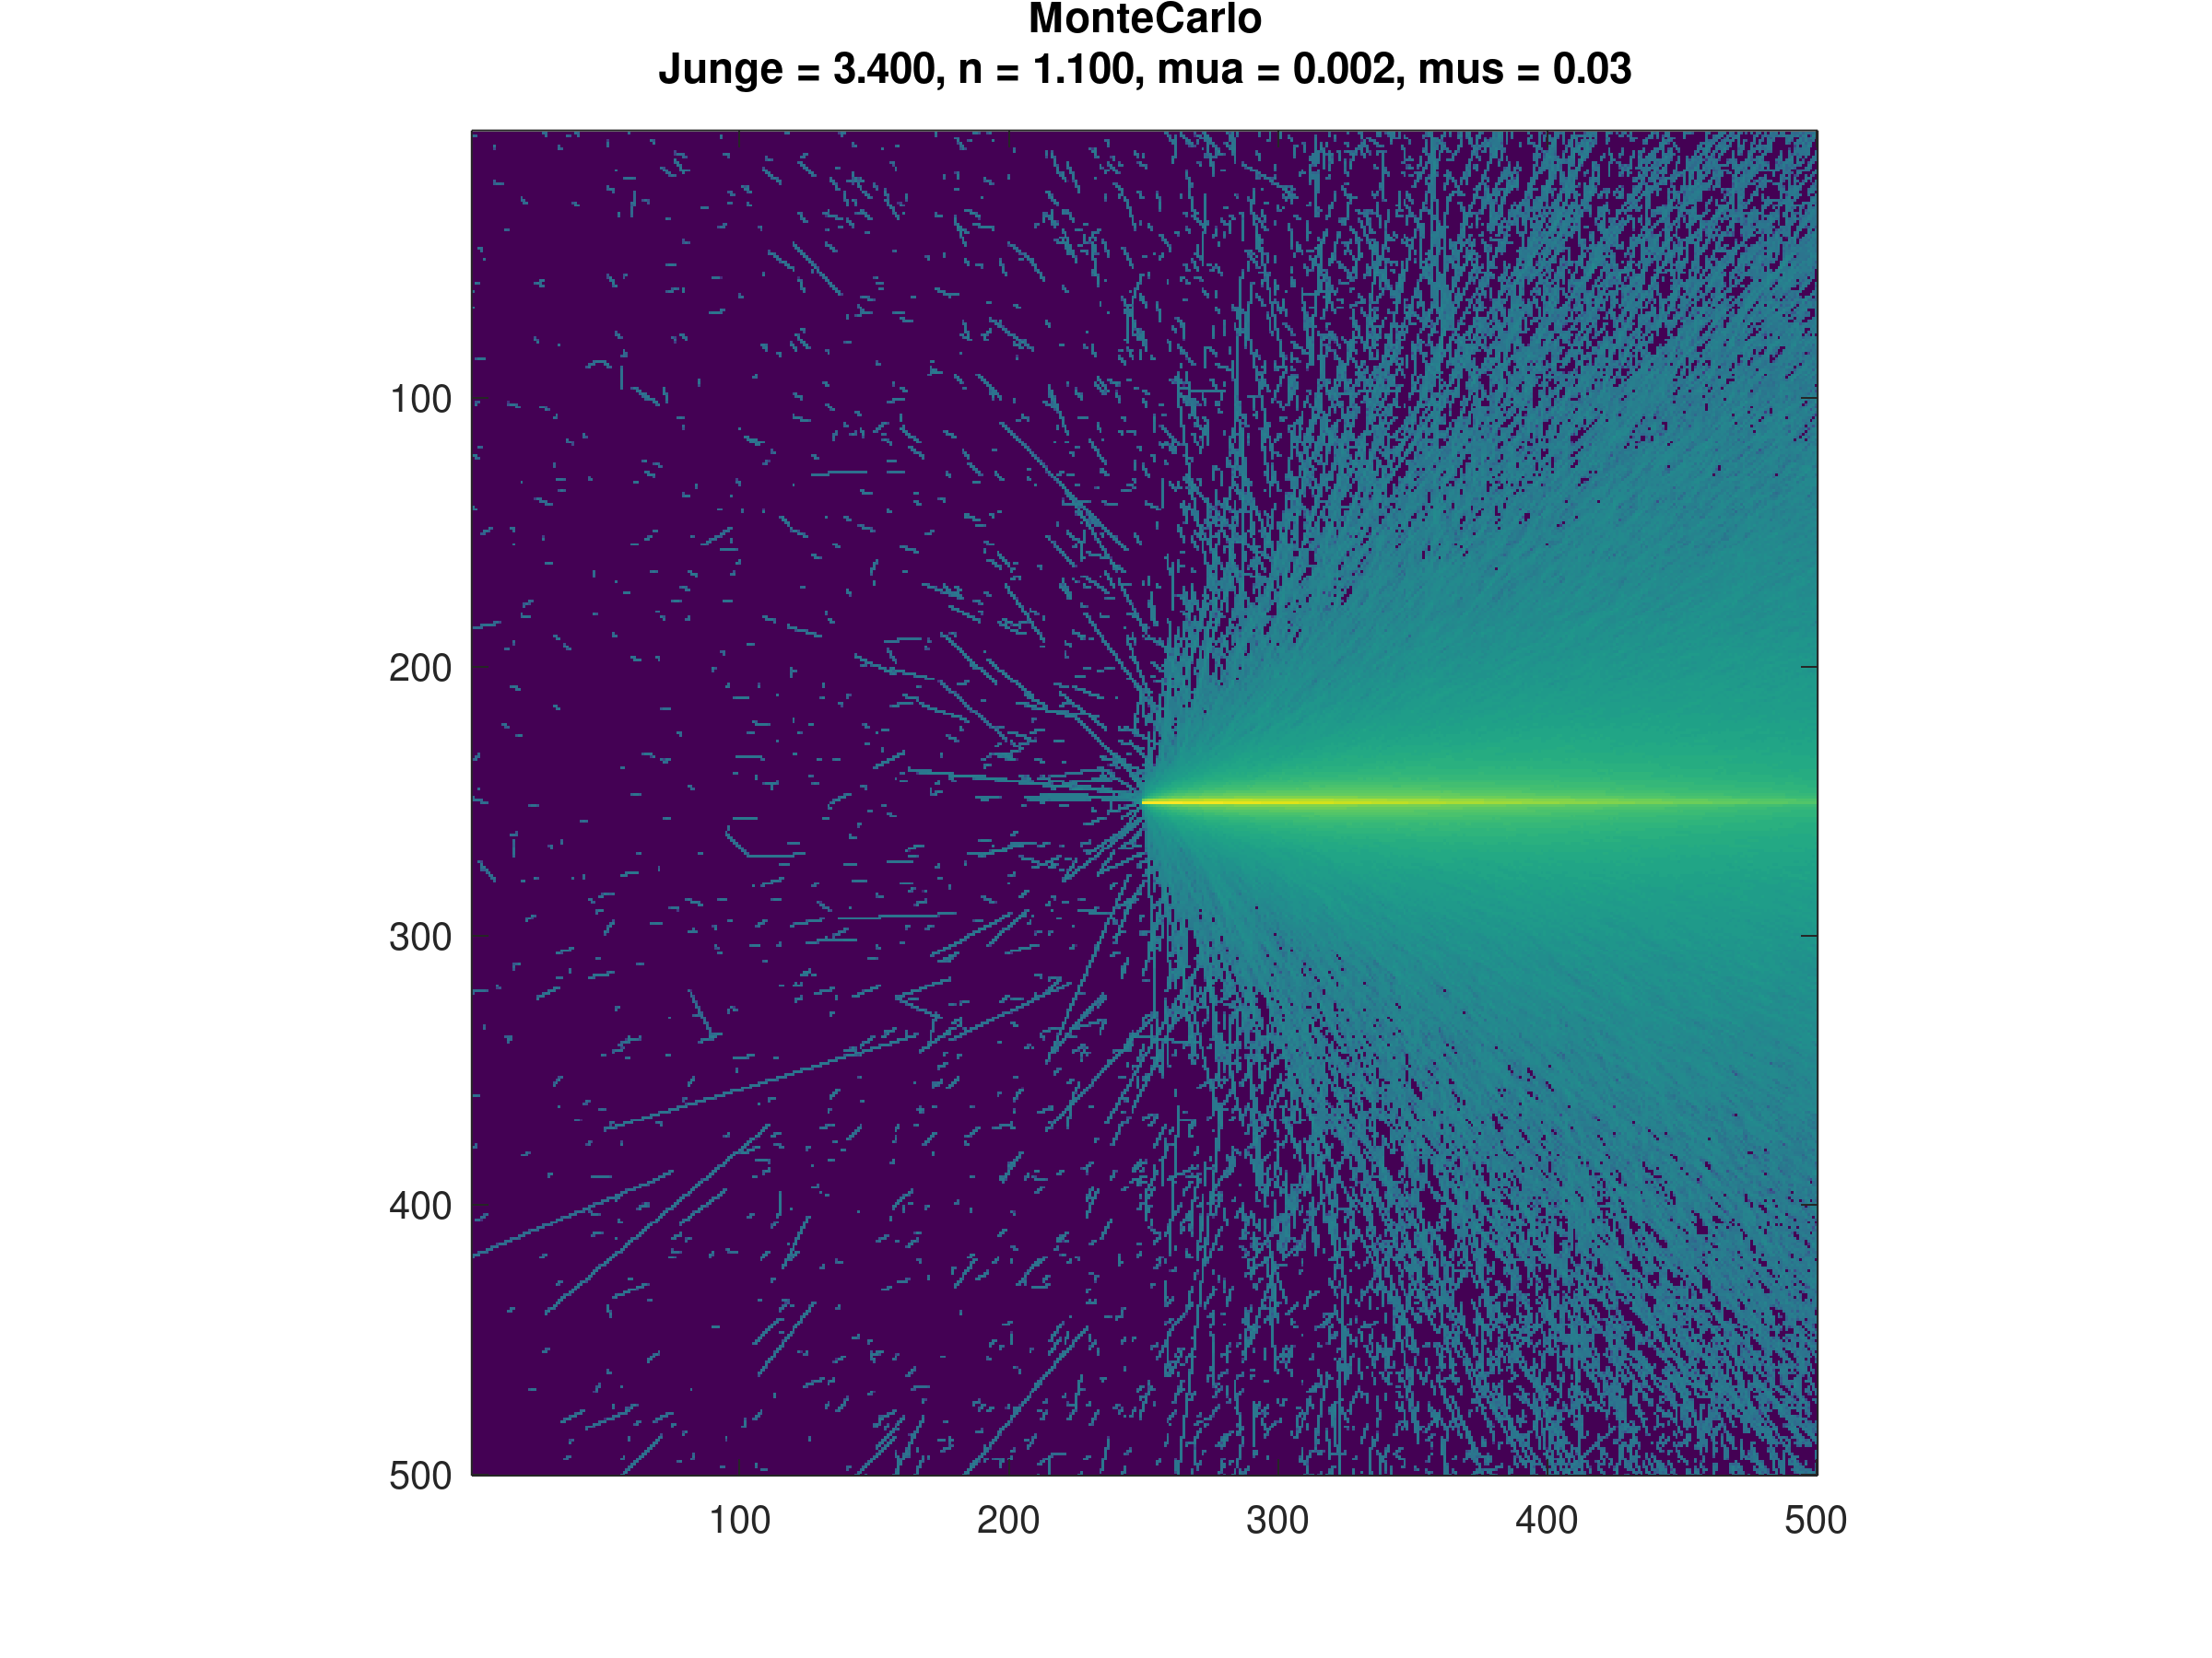
Turbidity Meter Simulation
Pre-Results Meeting

Slide 2
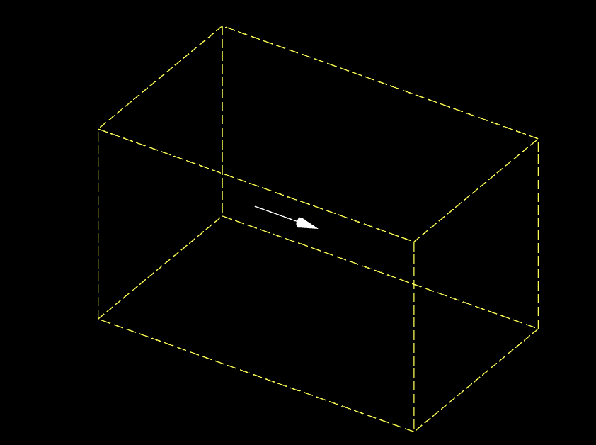
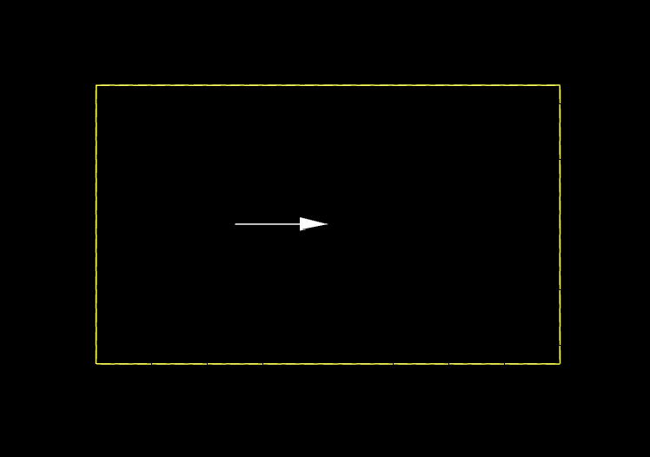
The Experimental Setup
The setup(1) consists of a source in the middle of out domain. The domain boundary is absorbant, and the source is a pencil source.
The source
Zone(1) of interest
Domain Boundary
Zone(2) of interest
X-Z plane of the experimental setup
3D image of the experimental setup

Slide 3
Simulation Innerworkings
Photon launches with a packet weight 1 and direction v
Based on an exponential distribution based on the scattering coefficient (μ_{s}) of the current voxel, it decides how many voxels to travel in v direction.
Steps 1 voxel in v direction and looses packet weight based on the absorption coefficient (μ_{a})
The packet weight is added to its current voxel’s raw probability,
The previous 2 steps are repeated until the package reaches the next scattering voxel decided in the second step
Calculate a new scattering direction vector: the azimuth and zenith scattering angles are computed, respectively, by a random number uniformly distributed in [0,2pi] and a random number between [0,pi) following an assigned phase function.
Repeat from step 2 until the max time is reached or the photon exits the domain
Repeat all steps for next photon

Slide 4
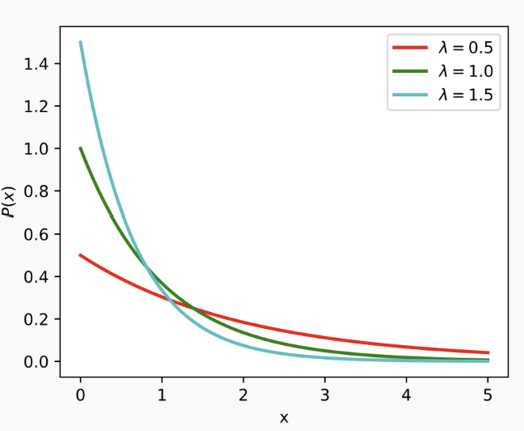
Photon Launches with weight 1 in v dir
Based on μ_{s}, photon travels n voxels
New scatter direction is determined
Previous steps are repeated until the boundary is left or no more time is left
n
Weight is reduced based on μ_{a}

Slide 5

Monte Carlo Simulation Result

Slide 6
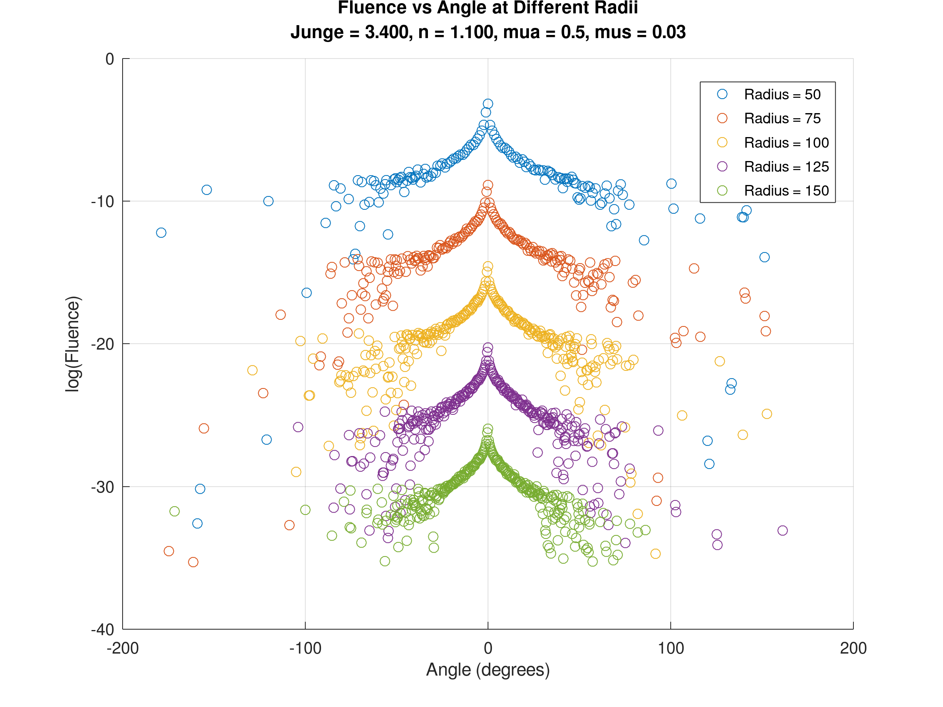
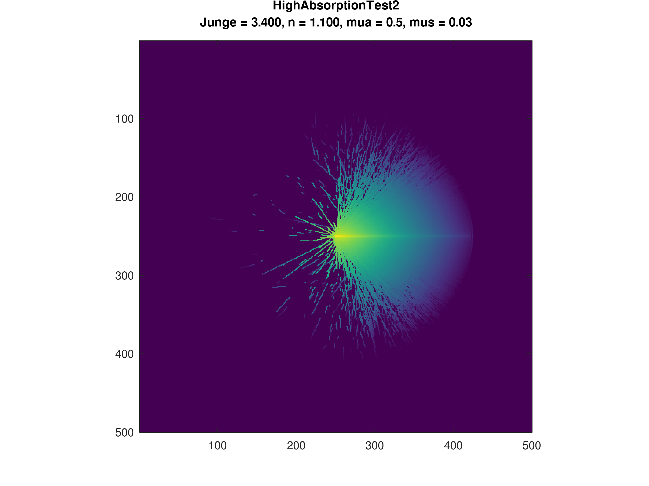

Slide 7
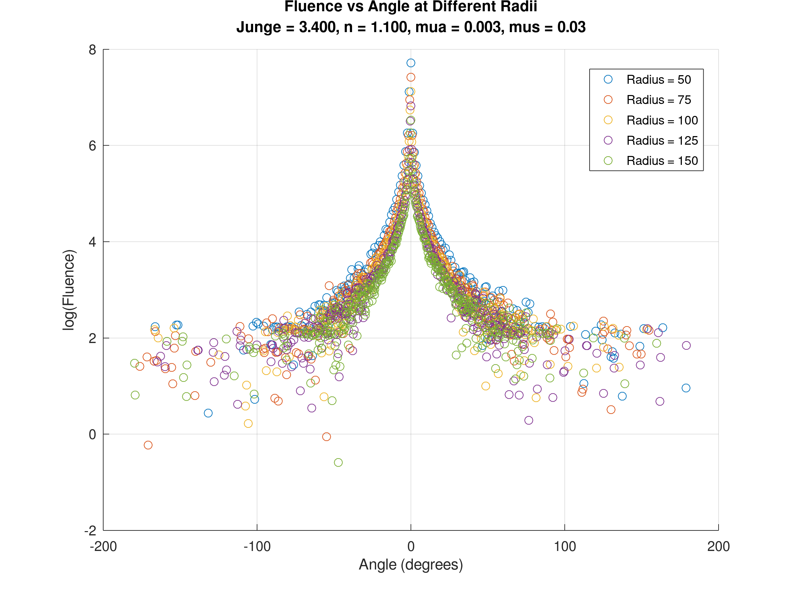
Angle test
For smaller radius the difference between the peak and bottom plateu become smaller from 4 times to 3 times the difference.
The issue is that these voxels have no min acceptance angle, so this is not an accurate representation of what the detector would see.

Slide 8
A better way
Imagine the image below is the x-y slice where the source is. The idea is to measure the light exiting the top boundary. Represent the intensity at the boundary along the y direction in a bar graph. Hence we know the best position to place the detector. The same can be done at the front face.
X-dir
Y-dir
50mm

Slide 9
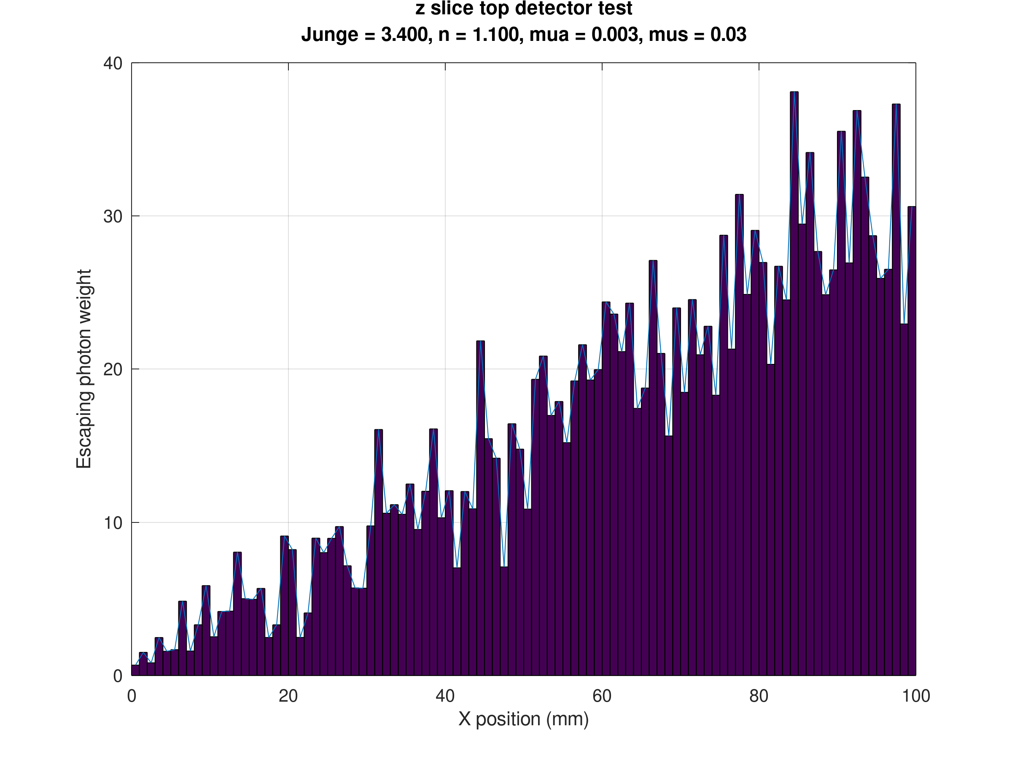
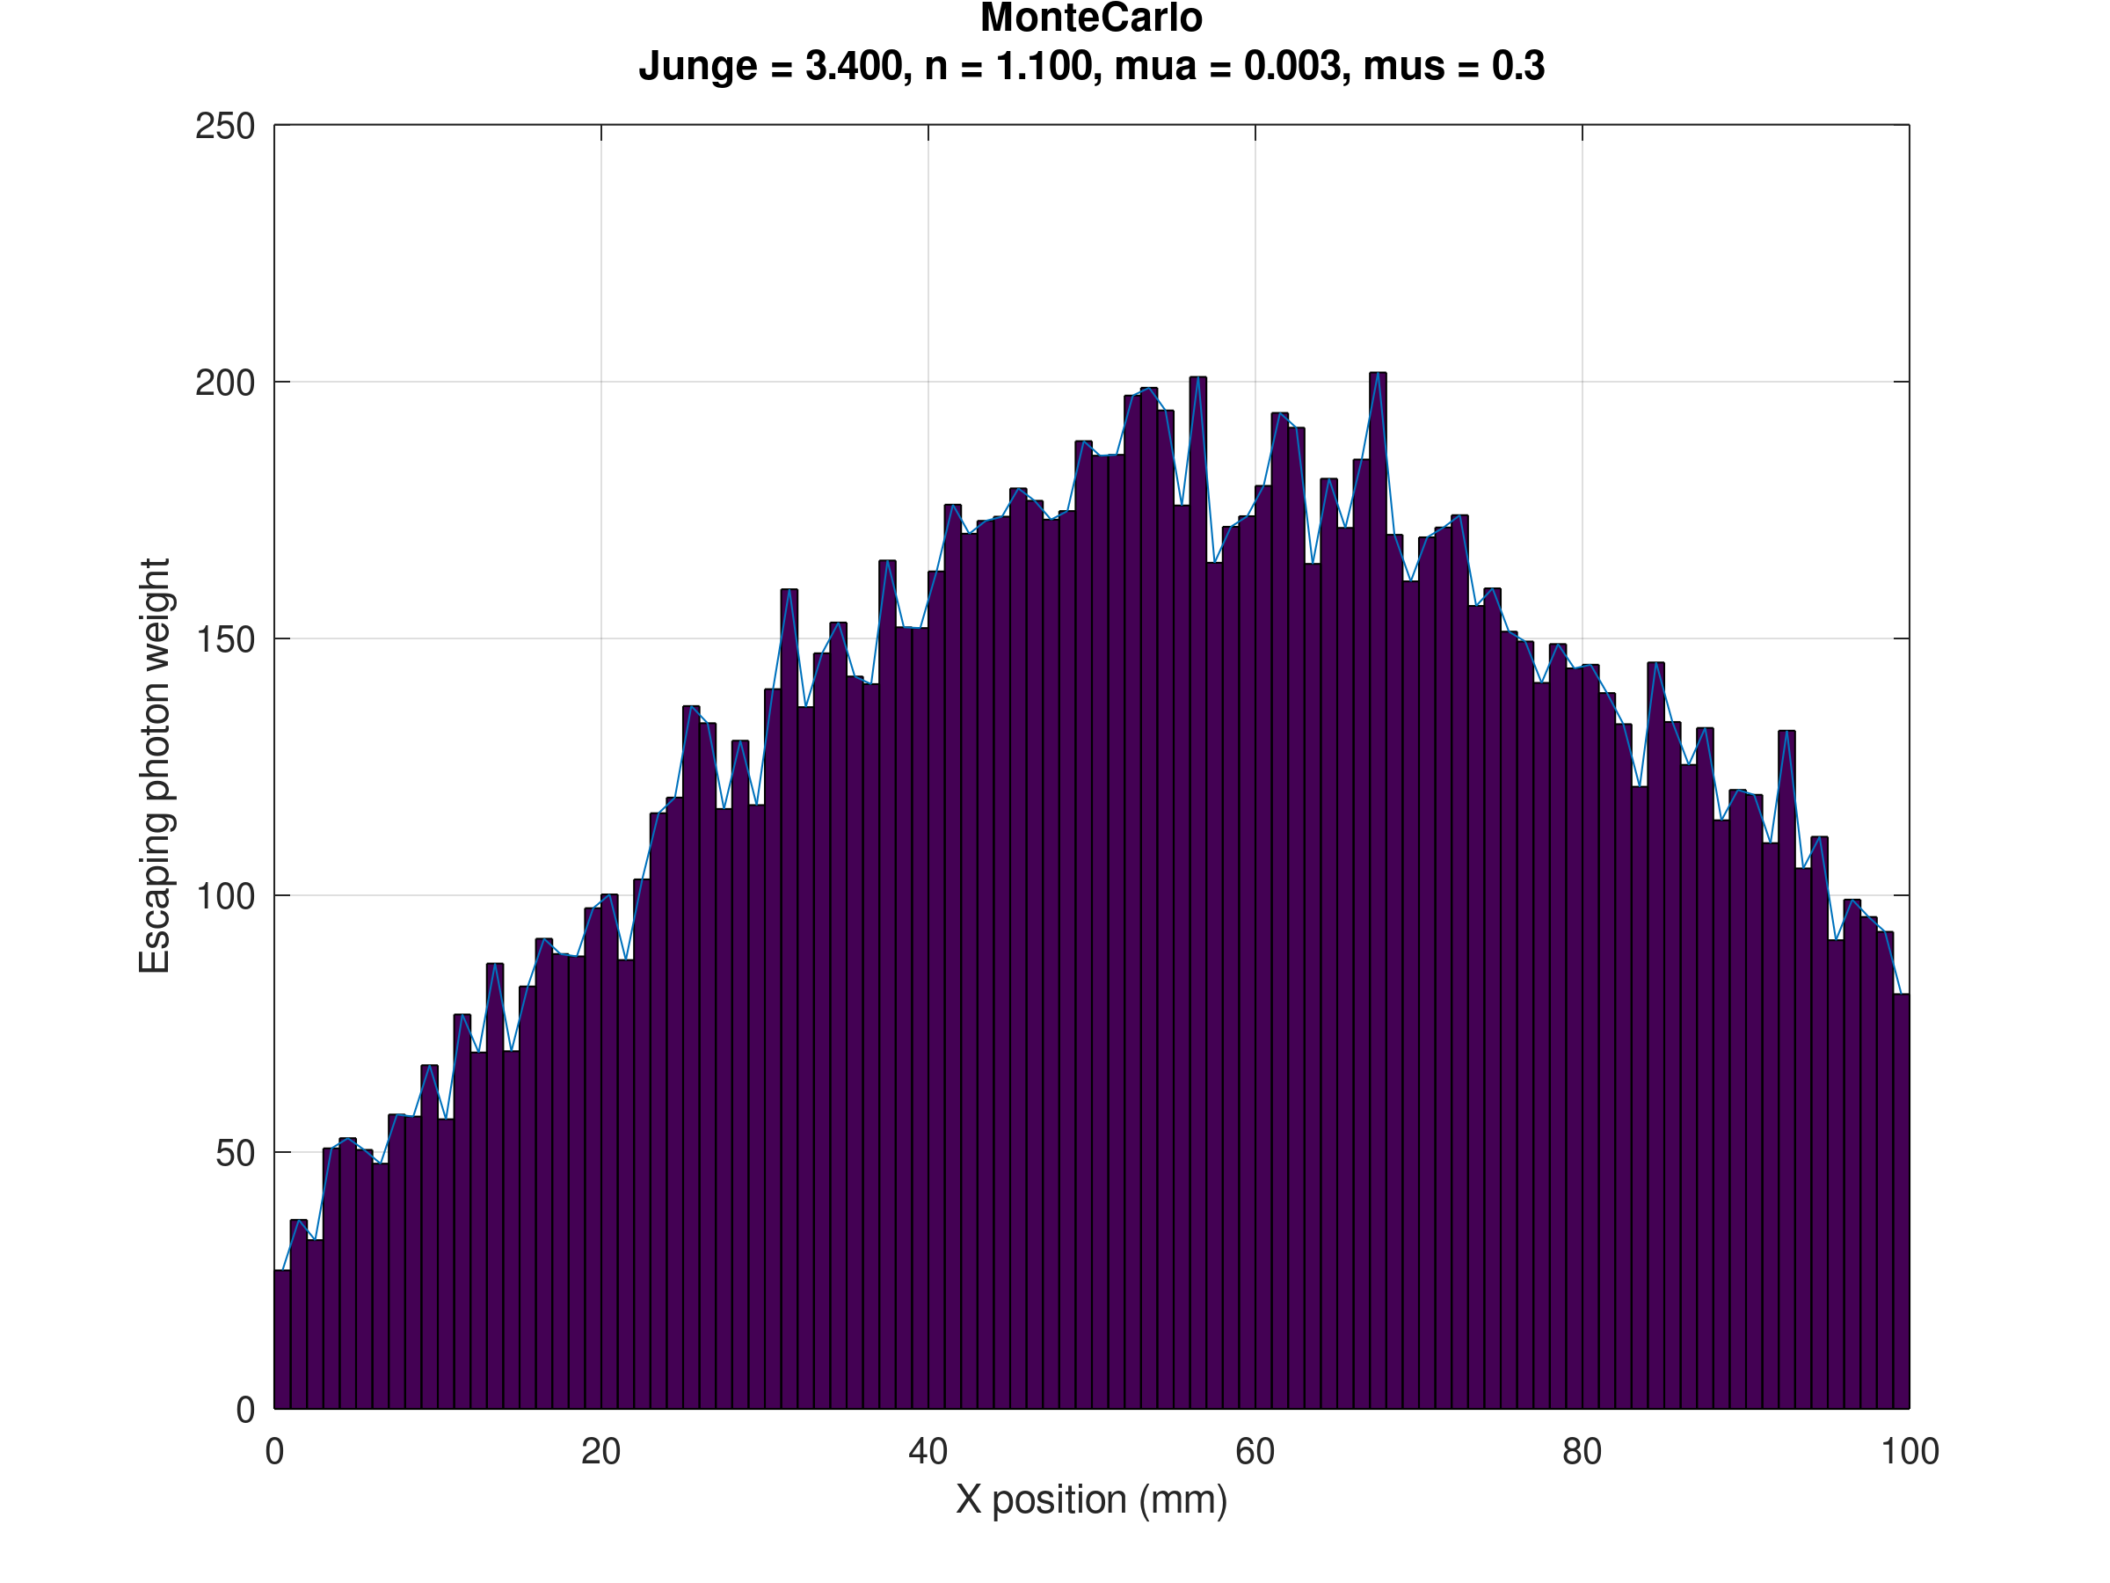
Results for the off beam detector at 50 mm

Slide 10
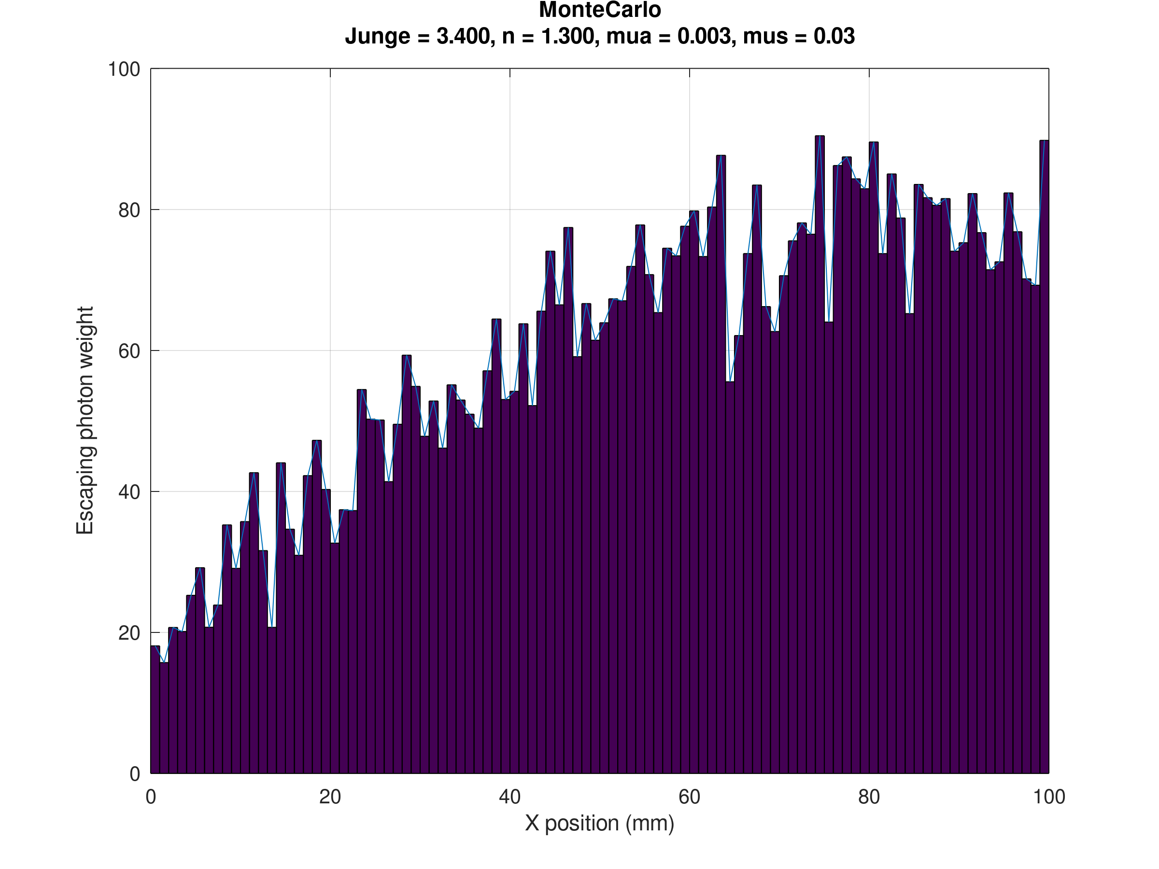
Results for the off beam detector at 50 mm continued

Slide 11
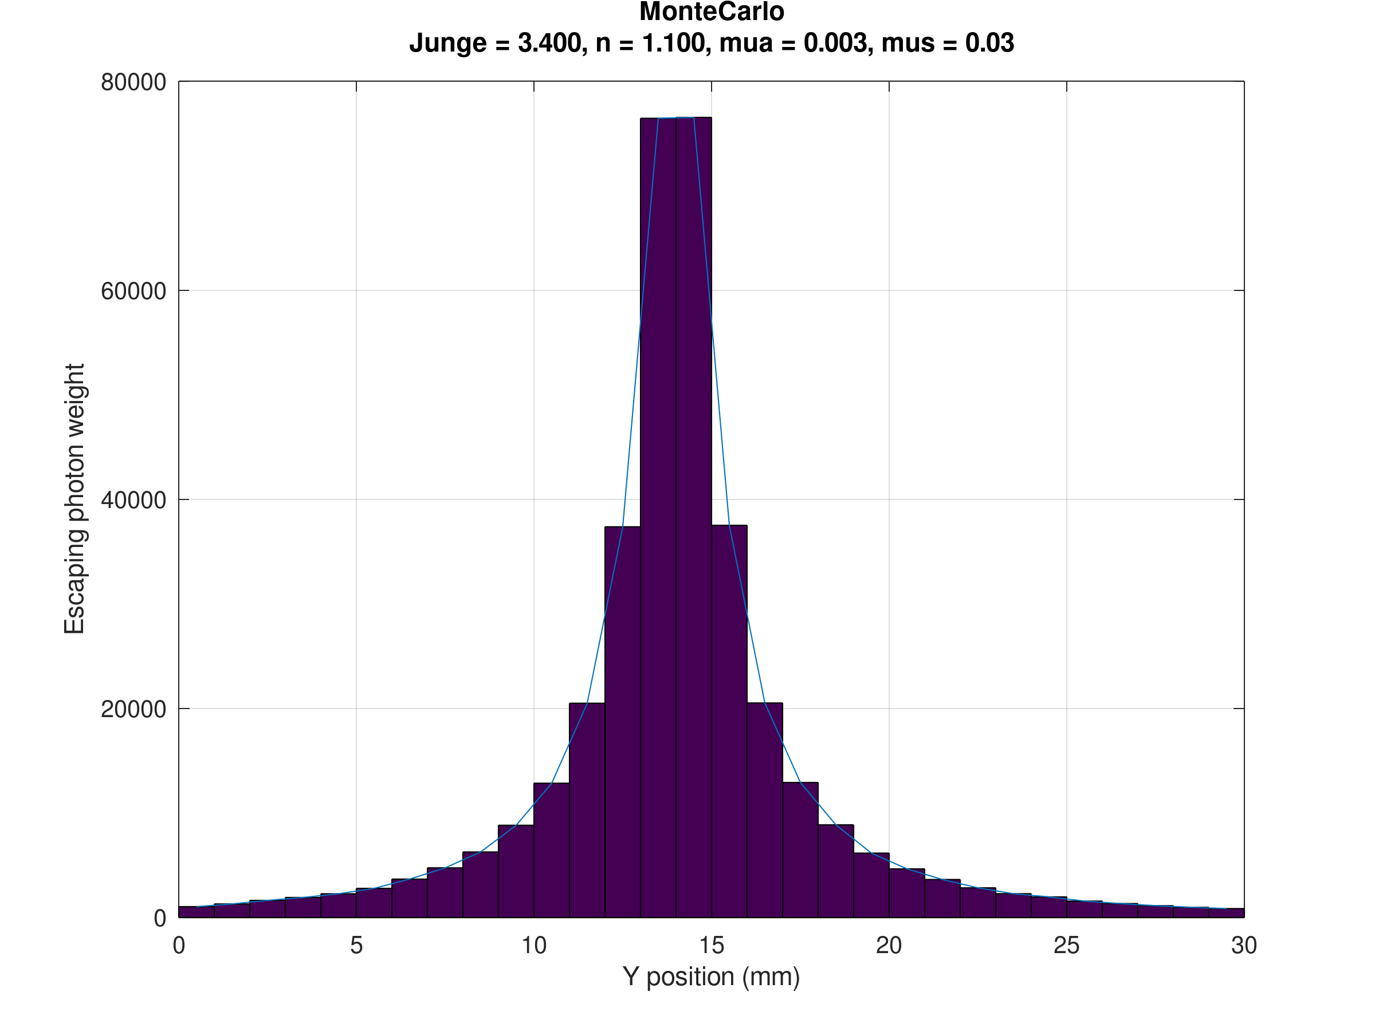
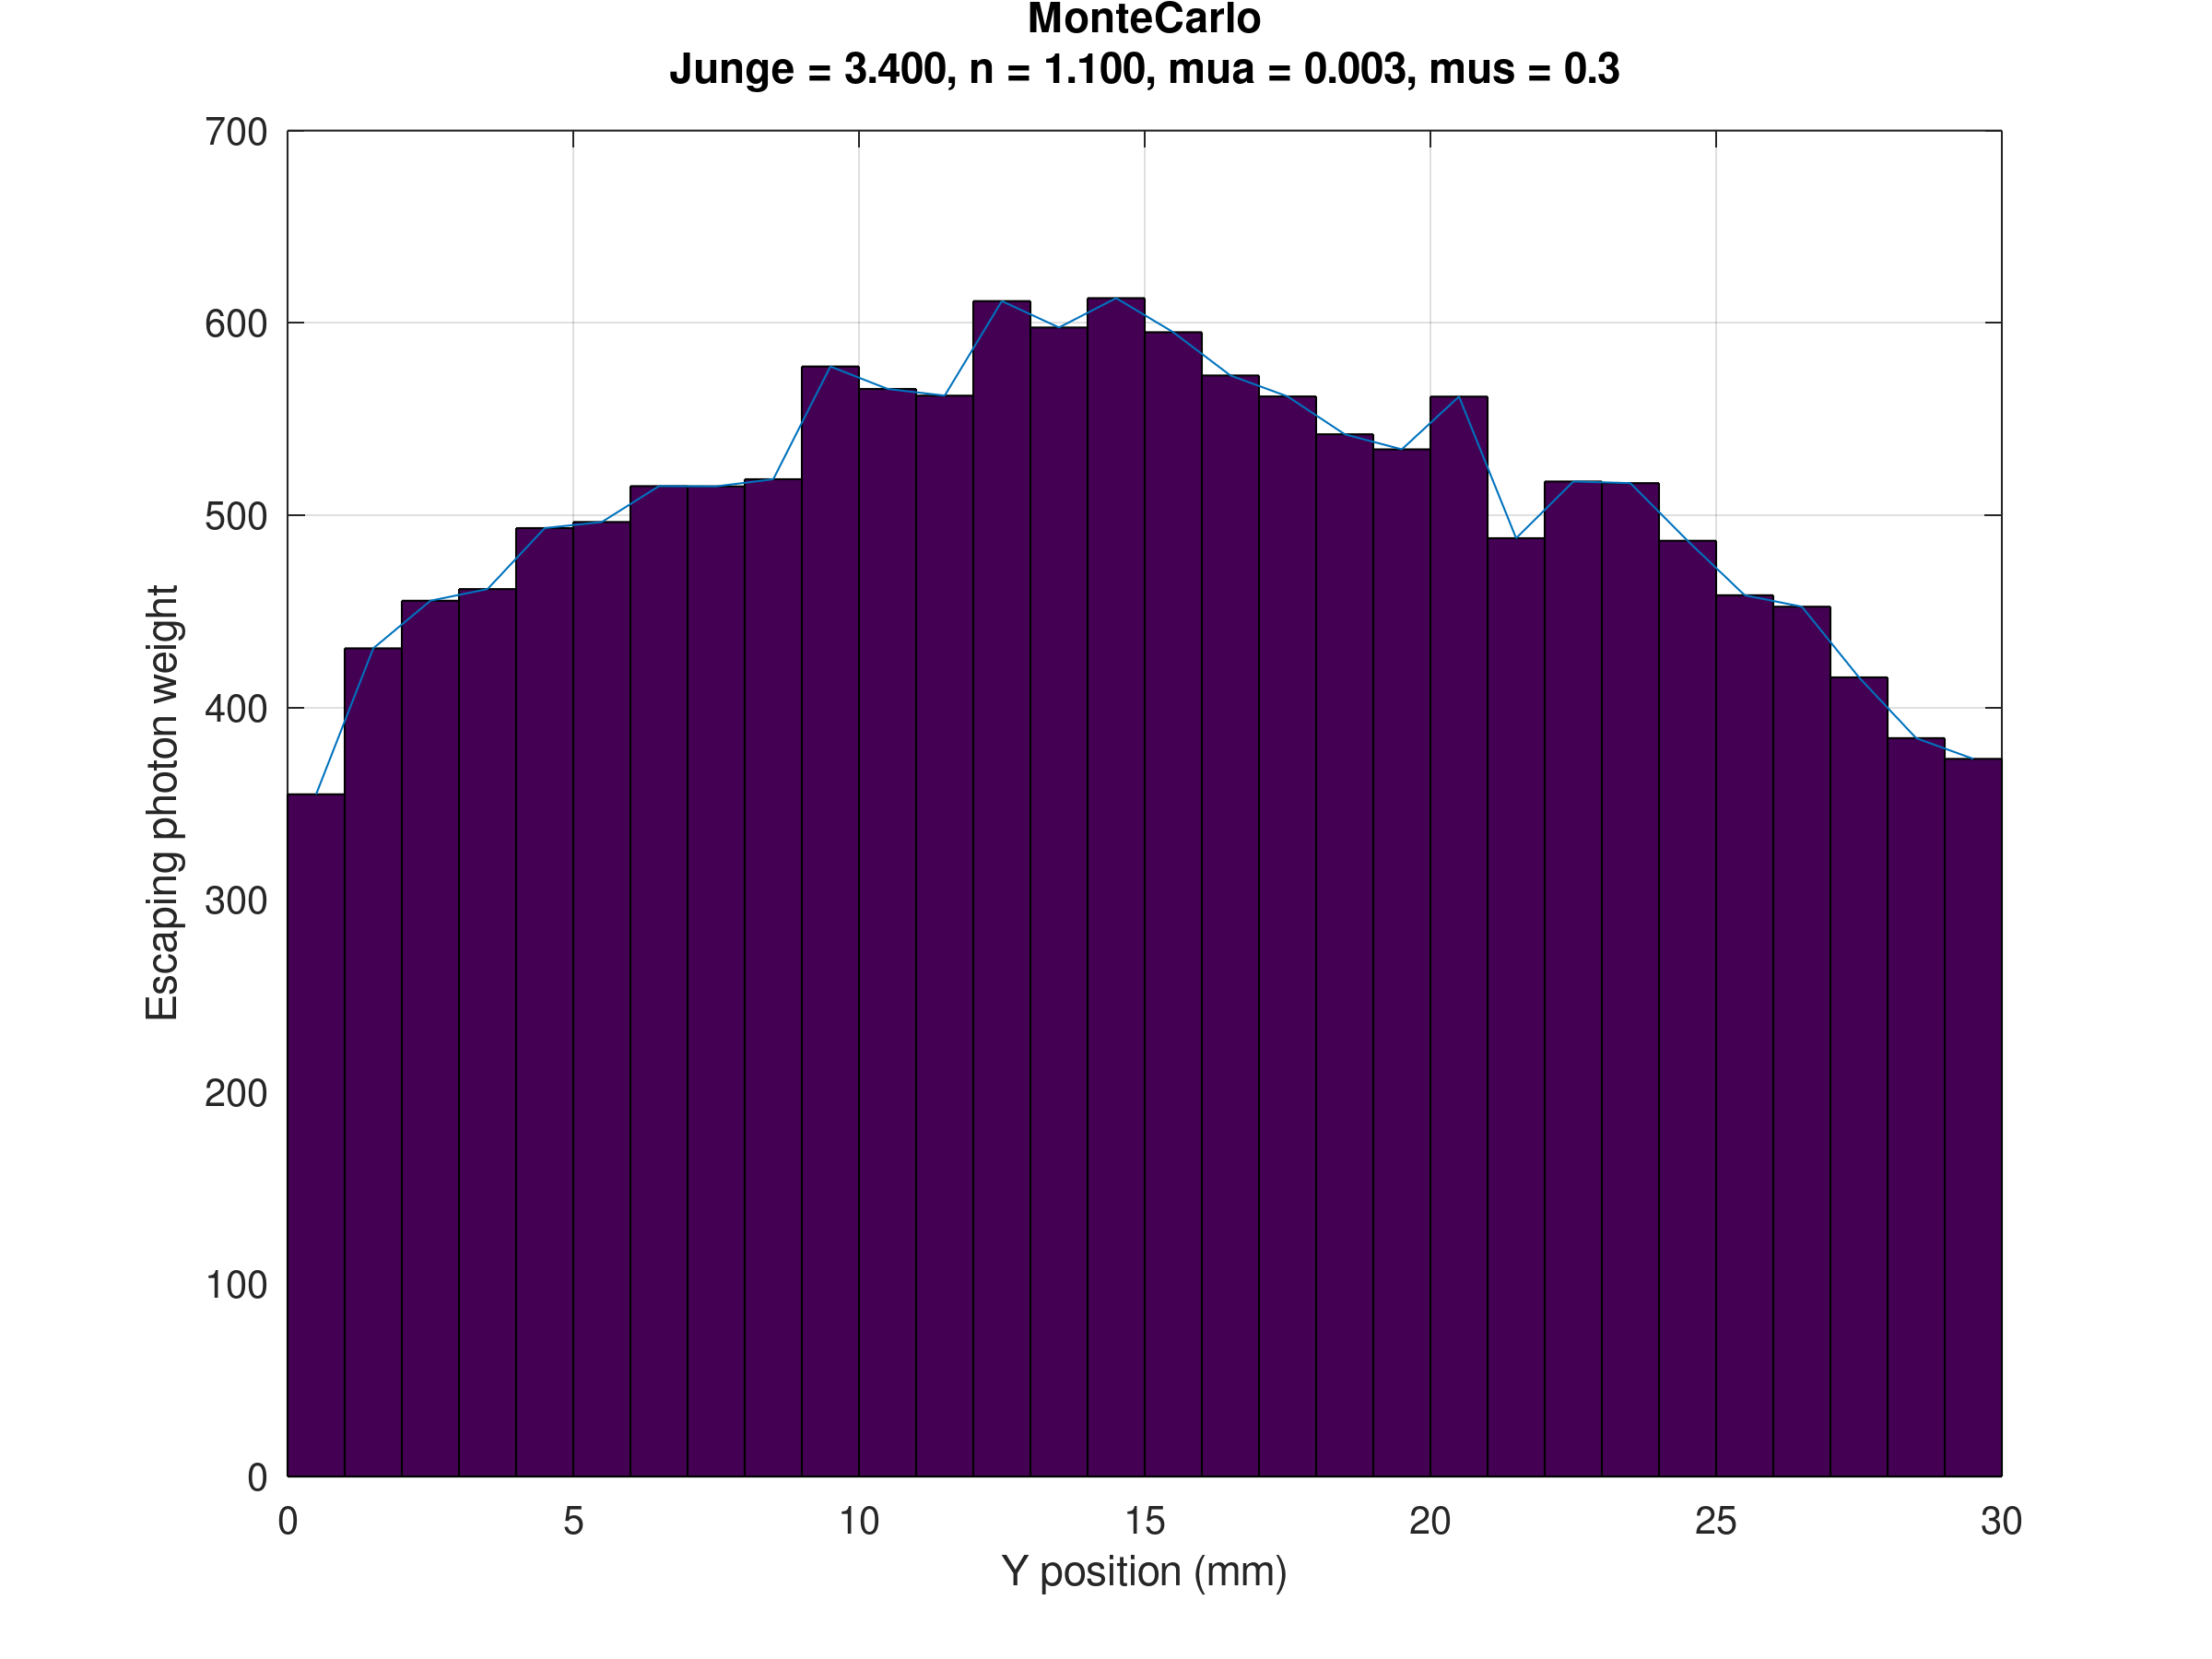
Results on the face perpendicular to the beamline at 100mm

Slide 12
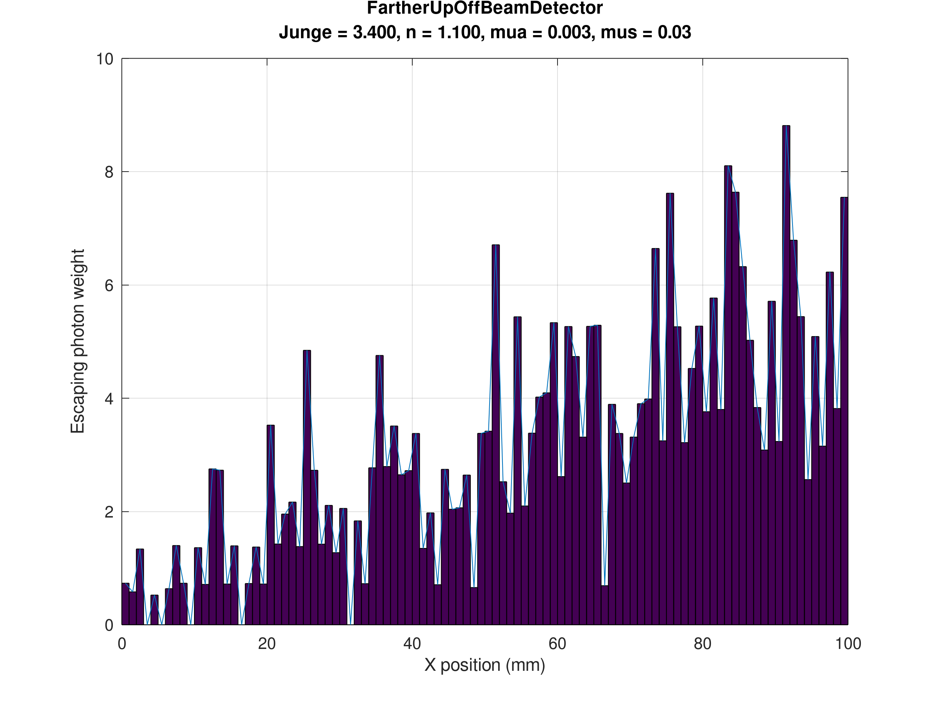
What if we go higher off the beam?
AT 100mm off beam
AT 50mm off beam

Slide 13
Sanity Checks
Under 0 scattering:
  Peak at zero degrees
  Absorption dependance must recover the beer lambert law
Under conditions where 1 scattering event per photon on average occurs:
  We must recover the Fornier Forand distribution
  HG and FF must be close
Under reasonable scattering:
  Increasing photon number must reduce std of solutions
  HG and FF must divarge
Under very large scattering:
  Source must look isotropic at a distance with no forward bias
  HG and FF must converge

Slide 14
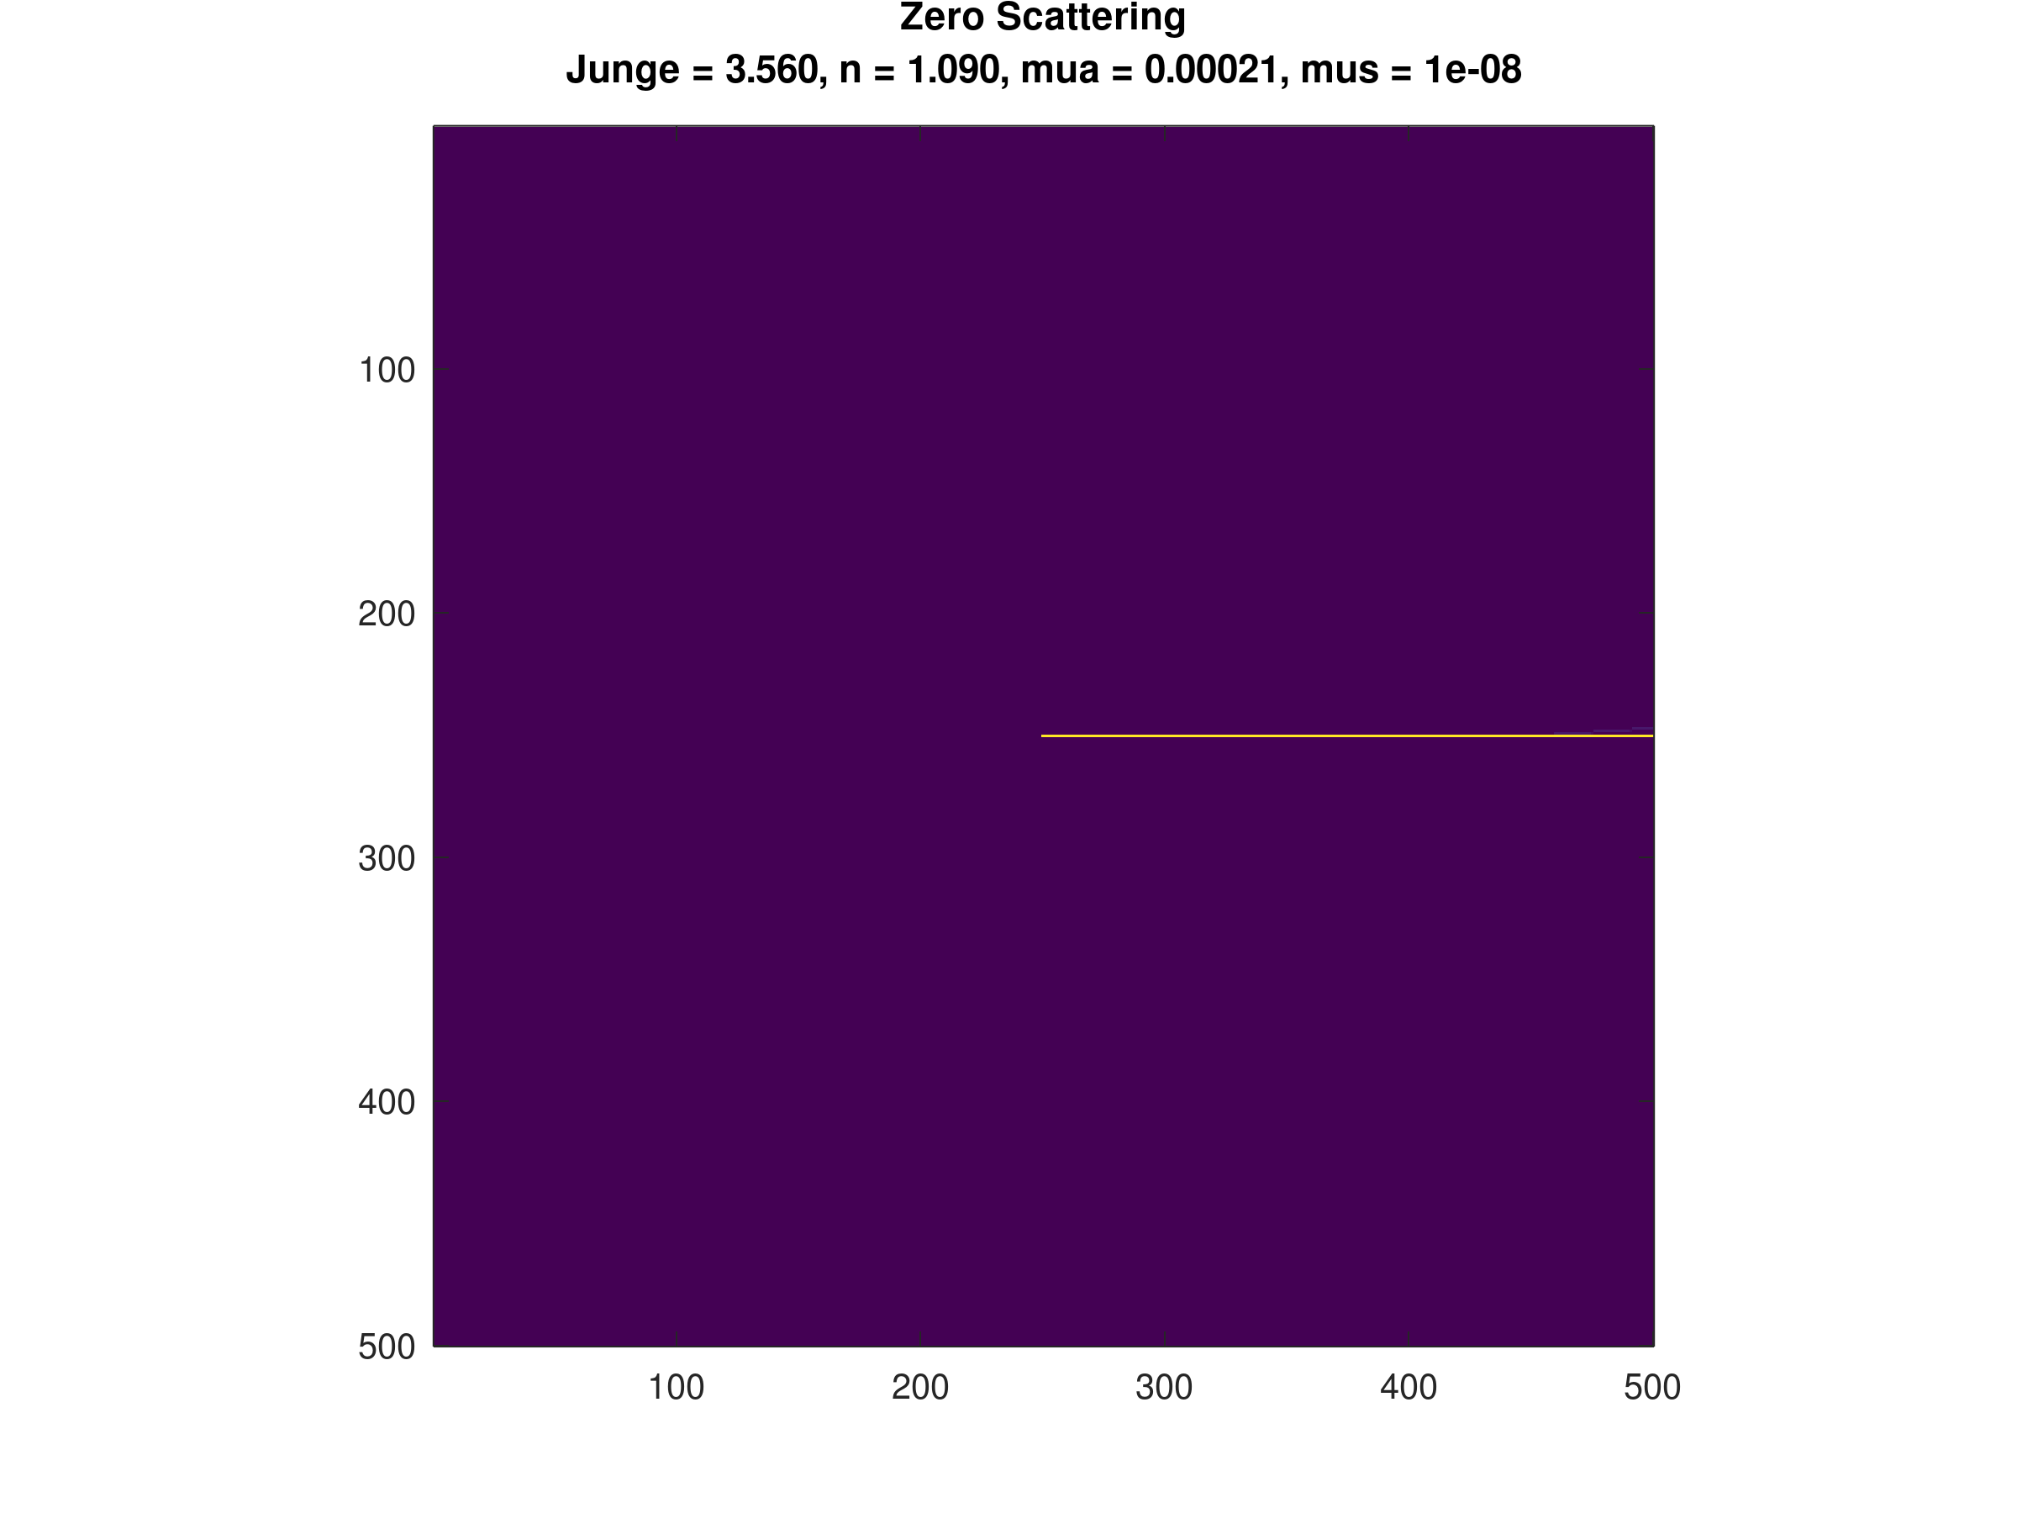
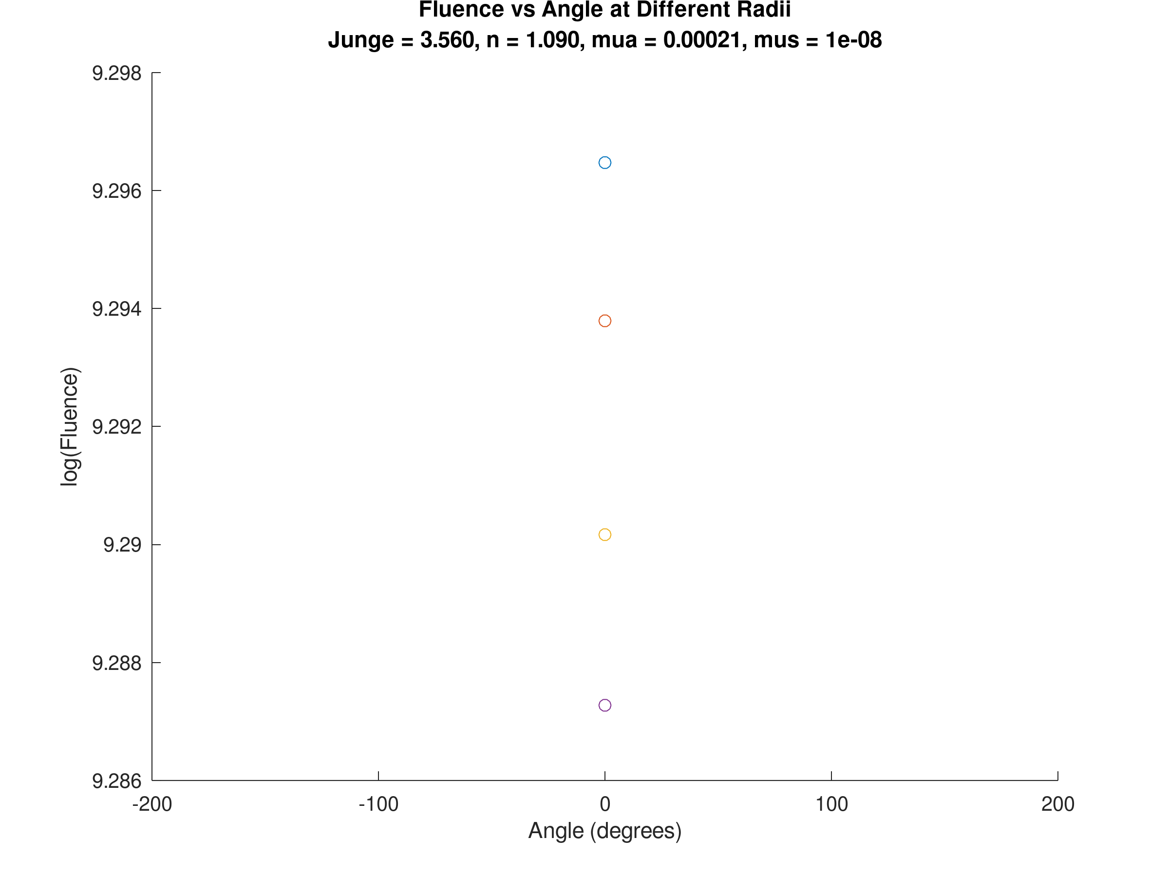
Zero Scattering Check
X-Y Slice of Monte Carlo Sim
Fluence measured at angles

Slide 15
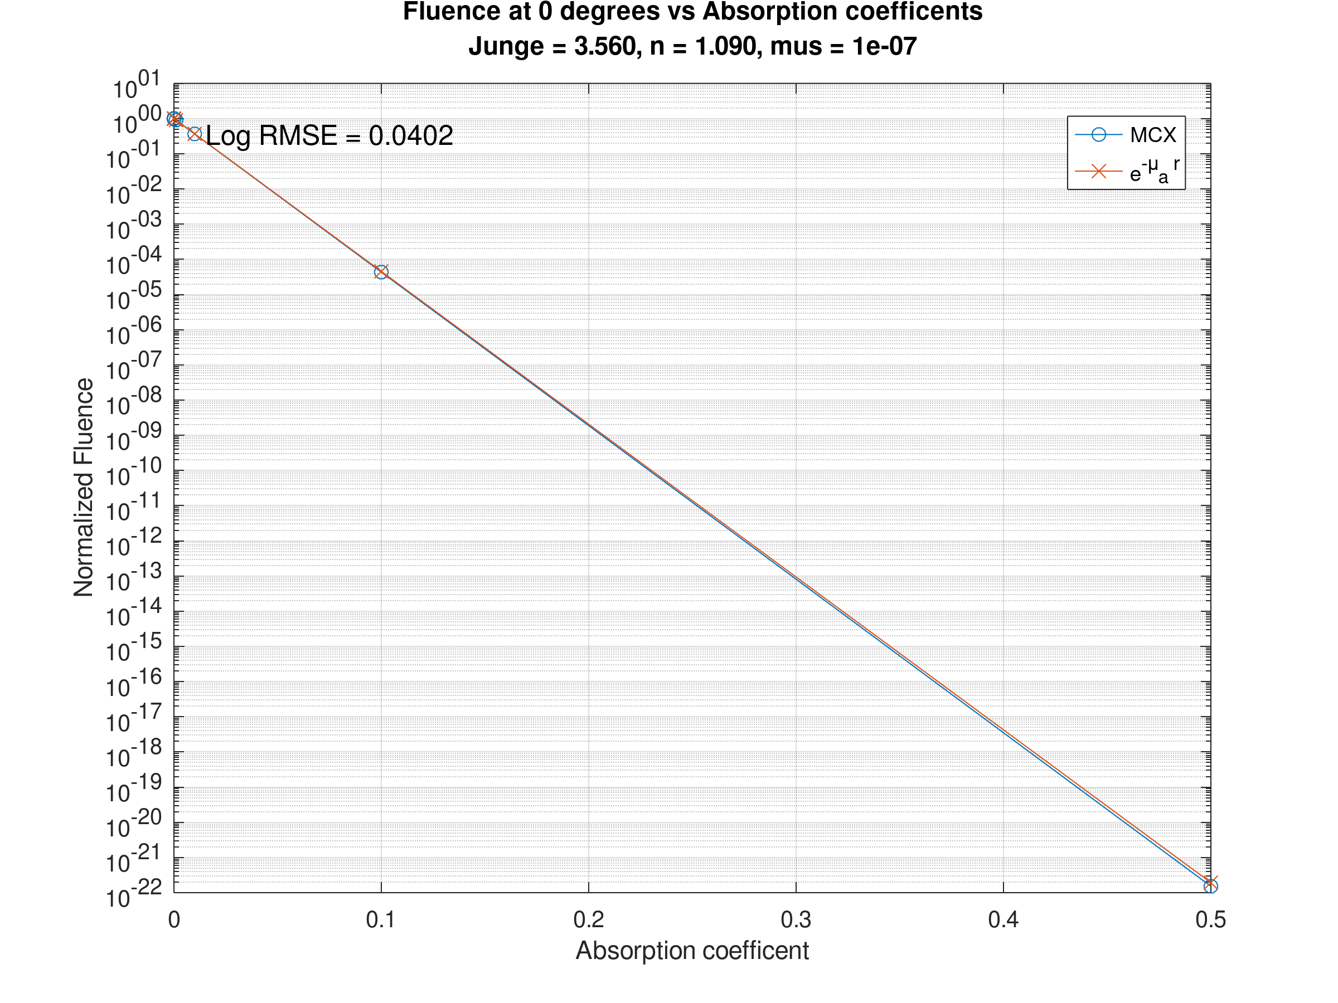
Absorption/Beer-Lambert Crosscheck
Absorption Coeff | Normalized Fluence | Beer-Lambert
1e-7 | 1.000 | 1.000
1e-5 | 1.007 | 0.999
1e-4 | 0.990 | 0.990
1e-3 | 0.904 | 0.904
1e-2 | 0.366 | 0.367
0.1 | 4.32e-5 | 4.54e-5
0.5 | ~0 | ~0

Slide 16
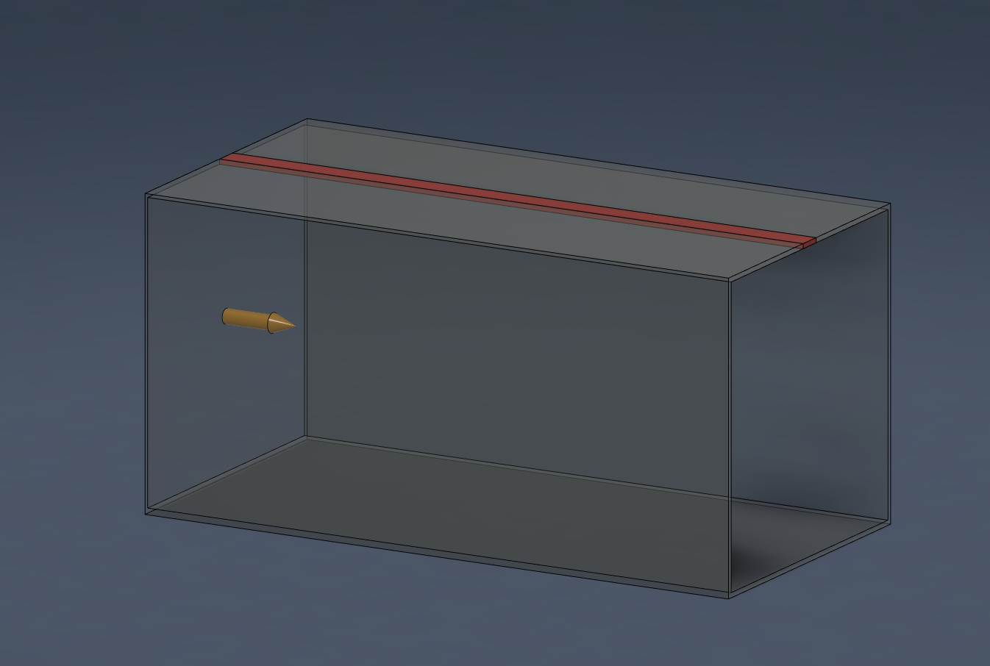

Slide 17
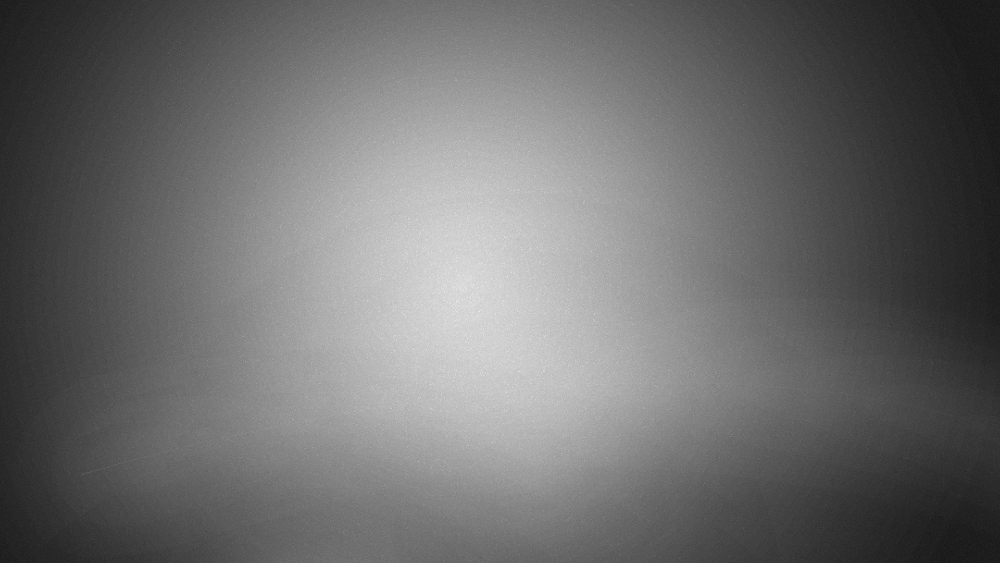
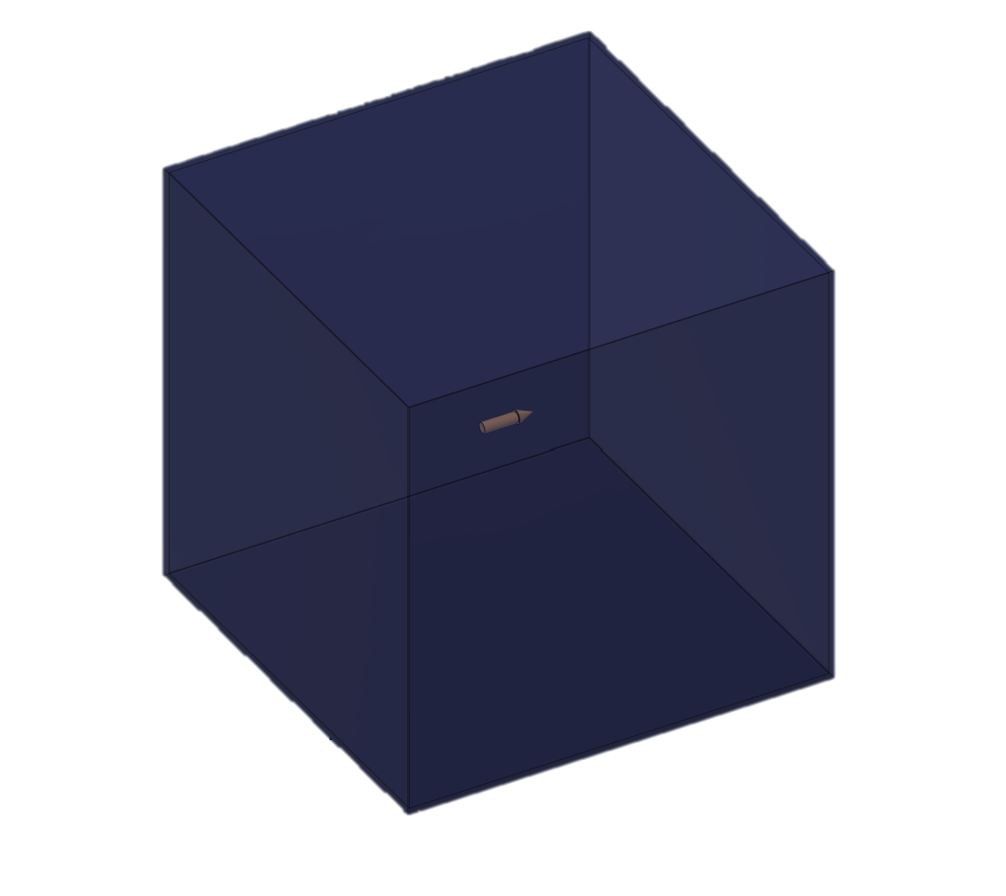
Source
250mm
250mm
250mm

Slide 18
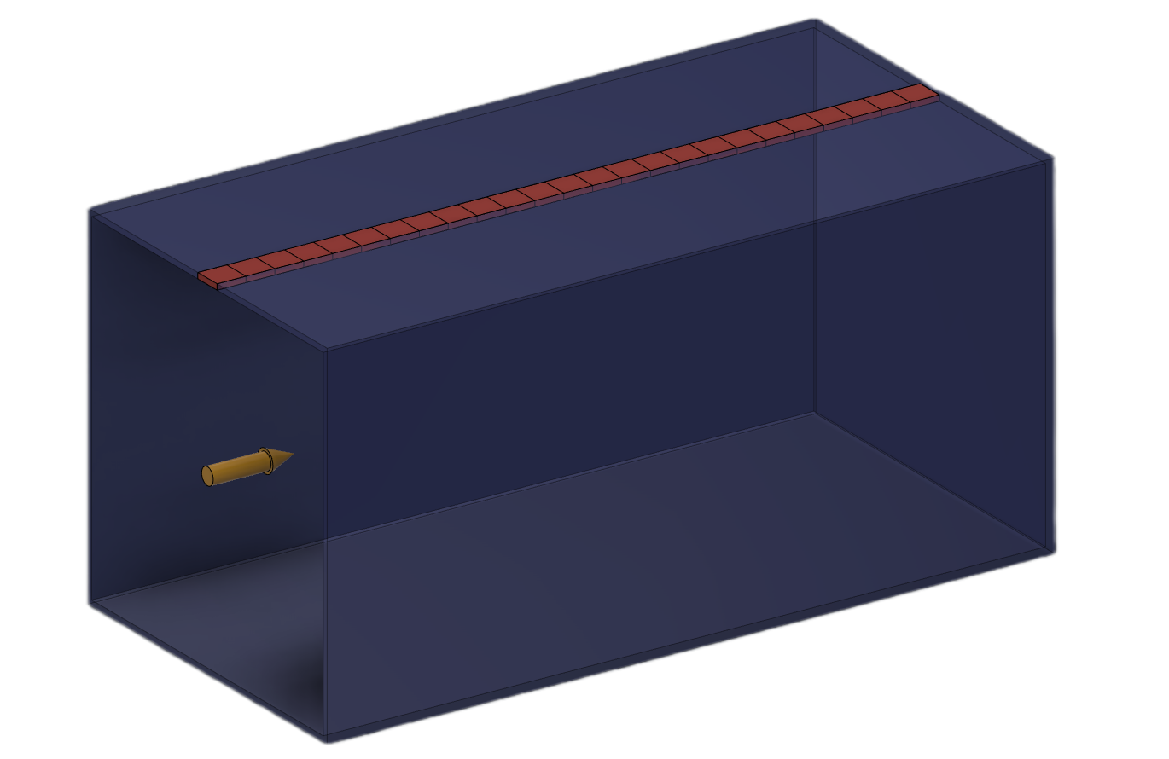

Each square serves as a $1{mm}^{2}$ detector
Variable lenght
30mm
100mm

Slide 19
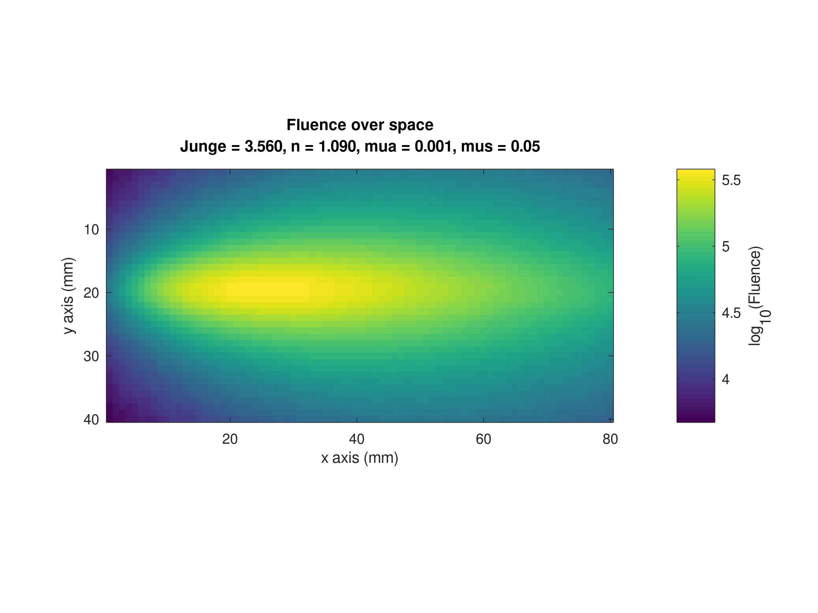

Slide 20
